Slide 1

A Semi-Supervised Self-Organizing Map for Clustering and Classiﬁcation
Pedro H. M. Braga and Hansenclever F. Bassani
Center of Informatics
Federal University of Pernambuco
Recife, Brasil
{phmb4, hfb}@cin.ufpe.br
July, 2018

Slide 2
Outline
Introduction
Background
Semi Supervised Self-Organizing Maps (SS-SOM)
Experimental Setup
Experimental Results and Analysis
Conclusion and Future Work

Slide 3
Introduction
In recent years, research on Artiﬁcial Neural Networks with supervised learning algorithms has made great advances (Robotics, Genomics, and Natural Language Processing).
These methods require a large amount of properly labeled data for training and it makes their use in many applications impractical.
At the current stage of research, it is of great importance to put forward methods that can beneﬁt both from the (frequently large amounts of) unlabeled data available as well as from the smaller amounts of labeled data, what would expand the current range of machine learning applications.
Semi-Supervised Learning (SSL) methods are used to achieve this (Zhu and Ghahramani, 2002)
Notes:
In recent years, research on Artiﬁcial Neural Networks with supervised learning algorithms has made great advances, often appearing in technology news with increasingly impressive practical applications in diverse areas, such as Robotics [1], Genomics [2], and Natural Language Processing [3].
Despite these advances, the fact that these methods require a large amount of properly labeled data for training (sometimes, in the order of thousands of patterns per class) makes their use in many applications impractical. In certain areas, such as in the medical ﬁeld, it is extremely difﬁcult and expensive to obtain balanced labeled datasets. In other areas, such as robotics, the dynamic imposed makes it impossible to have real-time labels. In addition, in certain problems, new categories of elements may frequently arise, making it infeasible to create a comprehensive previously labeled training dataset.
Therefore, at the current stage of research, it is of great importance to put forward methods that can beneﬁt both from the (frequently large amounts of) unlabeled data available as well as from the smaller amounts of labeled data, what would expand the current range of machine learning applications.
In order to achieve performance improvements, SemiSupervised Learning (SSL) methods take advantage of both unlabeled and labeled data [4]. Hence, SSL is halfway between supervised and unsupervised learning, being applied for both classiﬁcation and clustering tasks [5].

Slide 4
Introduction
Semi-Supervised Learning is halfway between supervised and unsupervised learning, being applied for both classiﬁcation and clustering tasks (Basu et al., 2002)
Prototype-based methods such as K-Means and Self-Organizing Maps (SOM) are examples that have been successfully applied in this area.
Kohonen proposed two very inﬂuential prototype-based methods:
SOM – Unsupervised (Kohonen, 1990)
Learning Vector Quantization (LVQ) – Supervised (Kohonen, 1995)
Why not a hybrid model?
Semi-Supervised Self-Organizing Map (SSSOM), which is an extension of Local Adaptive Receptive Field Dimension Selective Self-Organizing Map (LARFDSSOM – Bassani and Araujo, 2015), created by introducing important modiﬁcations to incorporate semi-supervised learning.
Notes:
In semi-supervised classiﬁcation, the training process tries to exploit additional information (often available as label classes) together with the unlabeled data to achieve a more accurate classiﬁcation function. In semi-supervised clustering, this prior information is used to obtain a better clustering performance
Prototype-based methods such as KMeans [5] and Self-Organizing Maps (SOM) [7], [8] are examples that have been successfully applied in this area.
Kohonen proposed two very inﬂuential prototype-based methods. SOM [7] is an unsupervised learning method frequently applied for clustering, and the Learning Vector Quantization (LVQ) [9] is a supervised learning method that shares many similarities with SOM, which is frequently applied for classiﬁcation. Therefore, these methods are good candidates for developing a hybrid approach for SSL. Various modiﬁcations of LVQ and SOM were proposed to improve their performance in more challenging datasets with thousands of dimensions, commonly found in areas such as data mining [10] and bioinformatics [2]. In this context, traditional distance metrics often applied in prototype-based methods may become meaningless due to the curse of dimensionality [11], in which objects may appear approximately equidistant from each other, what is aggravated by the presence of irrelevant dimensions in the dataset. SOM and LVQ-based methods usually deal with such problems by applying weights to the input dimensions, what has been shown to provide signiﬁcant performance improvements.

Slide 5
Background
Unsupervised Learning:
Can address the problem imposed by the high-dimensional and unlabeled data
The general task of clustering involves not only clustering the data but also identifying subsets of the input dimensions which are relevant to characterize each cluster.
One way to achieve this is by applying local relevances to the input dimensions (each cluster have their set of relevances). The identiﬁcation of which dimension is relevant or not is an important feature when working with high-dimensional data.
In this context, subspace clustering methods have been proposed aiming to determine clusters in subspaces of the input dimensions of a given dataset
DSSOM, LARFDSSOM
Supervised Learning:
Some methods for classiﬁcation were proposed to deal with high-dimensional data: SVMs, MLP, GRLVQ etc.

Slide 6
Background
Semi-Supervised Learning:
Semi-supervised K-means-based methods were very successful demonstrating their advantages over standard approaches. It can be viewed as an instance of the EM algorithm. The labeled data provides prior information about the conditional distribution of hidden category labels, working as a guide for the clustering process.
Label propagation (LP) is another approach for SSL. LP methods operate on proximity graphs or connected structures to spread and propagate information about the class to nearby nodes according to a similarity matrix. It is based on the assumption that nearby entities should belong to the same class, in contrast to far away entities (Zhu and Ghahramani, 2002)
A similar alternative to LP is called Label Spreading (LS). It differs from LP in modiﬁcations to the similarity matrix. LP uses the raw similarity matrix constructed from the data with no changes, whereas LS minimizes a loss function that has regularization properties allowing it to be often better regarding robustness to noise (Zhou et al., 2004)
Notes:
K-means is one of the most popular and simple clustering algorithms. Despite the fact that K-means was proposed over 50 years ago, it is still widely used, and many variations have been proposed.

Slide 7
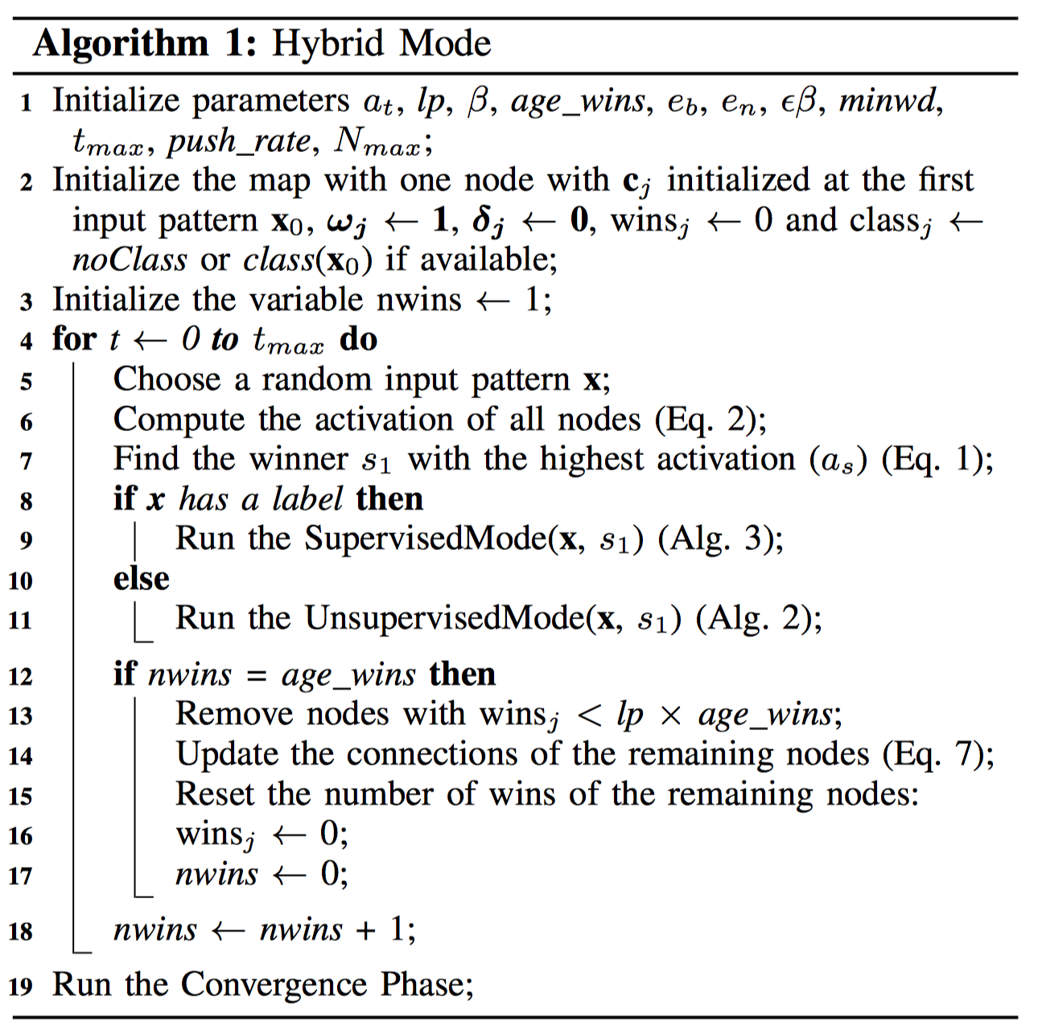
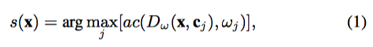
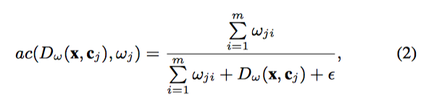
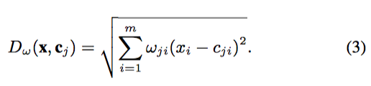
SS-SOM
A semi-supervised hybrid SOM, based on LARFDSSOM
Time-varying structure
It can learn in a supervised or unsupervised way
It includes concepts from the standard LVQ when the class label of some input pattern is given
Initialization
Organization
Convergence

Slide 8
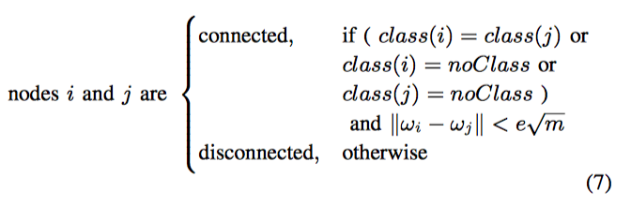
SS-SOM
Other Common Operations
Nodes removal
Neighborhood Update

Slide 9
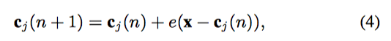
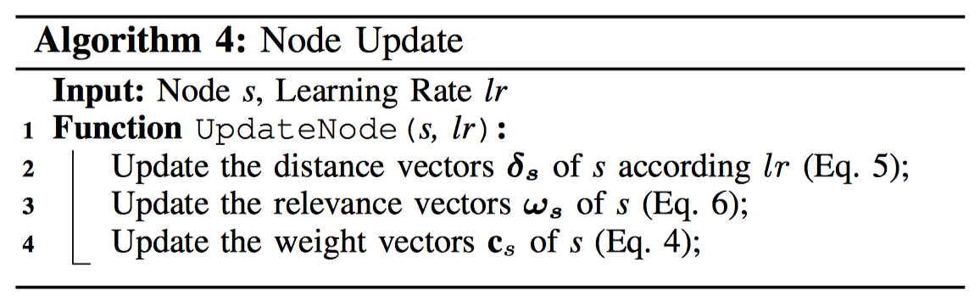
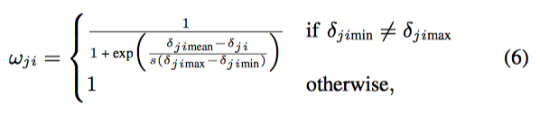
SS-SOM
Other Common Operations

Slide 10
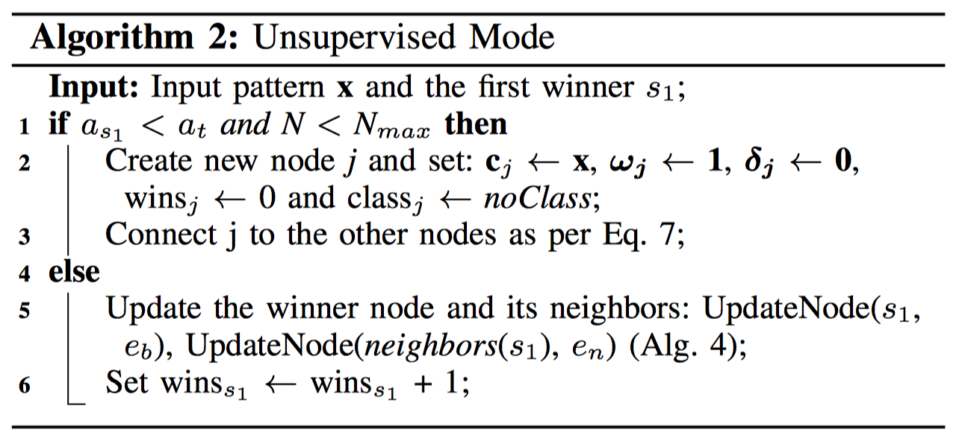
SS-SOM

Slide 11
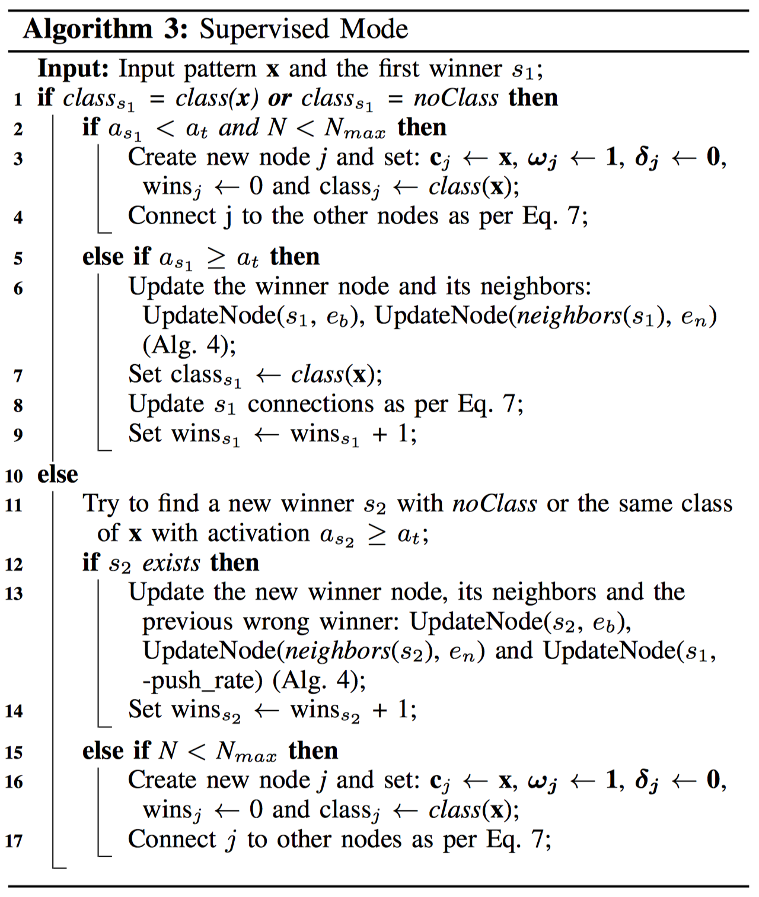
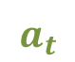
SS-SOM
When the winner node has the same class of a given sample:
x_{i}
$$a_{t}$$
w⁺
Nodes of Class 1
Nodes of Class 2
Nodes of Undefined Class

Slide 12
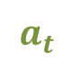
SS-SOM
When the winner node class is not defined:
x_{i}
w⁺
$$a_{t}$$
Nodes of Class 1
Nodes of Class 2
Nodes of Undefined Class

Slide 13
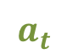
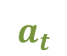
SS-SOM
When a given labeled given sample has not a representative winner node:
x_{i}
$$a_{t}$$
$$a_{t}$$
Nodes of Class 1
Nodes of Class 2
Nodes of Undefined Class

Slide 14
SS-SOM
When a given unlabeled given sample has not a representative winner node:
x_{i}
$$a_{t}$$
$$a_{t}$$
Nodes of Class 1
Nodes of Class 2
Nodes of Undefined Class

Slide 15
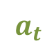
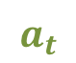
SS-SOM
When the winner node and a given labeled sample have different classes and a new valid winner is found:
$$a_{t}$$
X
x_{i}
w⁺
$$a_{t}$$
Nodes of Class 1
Nodes of Class 2
Nodes of Undefined Class

Slide 16
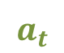
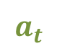
SS-SOM
When the winner node and a given labeled sample have different classes, and there is no new valid winner:
X
x_{i}
$$a_{t}$$
X
$$a_{t}$$
w⁺
Nodes of Class 1
Nodes of Class 2
Nodes of Undefined Class

Slide 17
Experimental Setup
Compared it with:
3 supervised methods: MLP, SVM and GRLVQ
2 semi-supervised methods: Label Spreading and Label Propagation
Real-word Datasets: Breast, Diabetes, Glass, Liver, Pendigits, Shape and Vowel
For all methods, on each dataset, we used a cross-validation. Each method was trained and tested 500 times for each fold with different parameter values sampled according to a Latin Hypercube Sampling (LHS) (Helton et al., 2005)
Mean and standard deviation of the best results were calculated separately for each dataset

Slide 18
Experimental Setup
For studying the effects of the different levels of supervision, the semi-supervised methods were trained with the following percentages of labeled data: 1%, 5%, 10%, 25%, 50%, 75% and 100%.
Classification and Clustering:
All nodes labeled: straightforward
Some nodes labeled: continue looking for another node with a deﬁned class label, and an activation above the threshold
No nodes labeled: we can identify the clusters of the input patterns, but not their classes.
For classiﬁcation purposes, if available, we use the node class as the predicted class. Otherwise, it is straightforwardly considered as an error.
Notes:
, where each sample should be assigned to a single cluster, and SS-SOM was set to operate in such mode

Slide 19
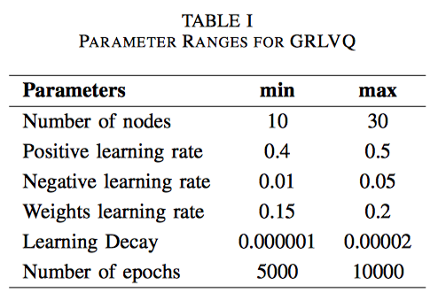
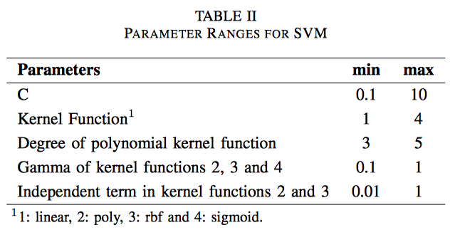
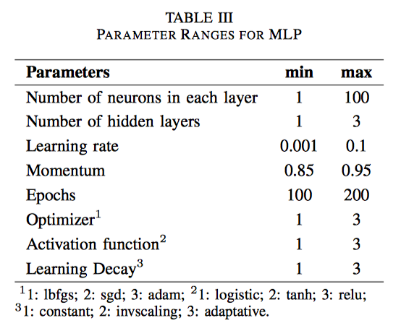
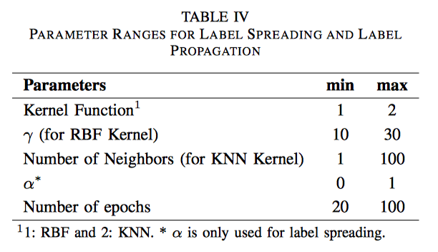
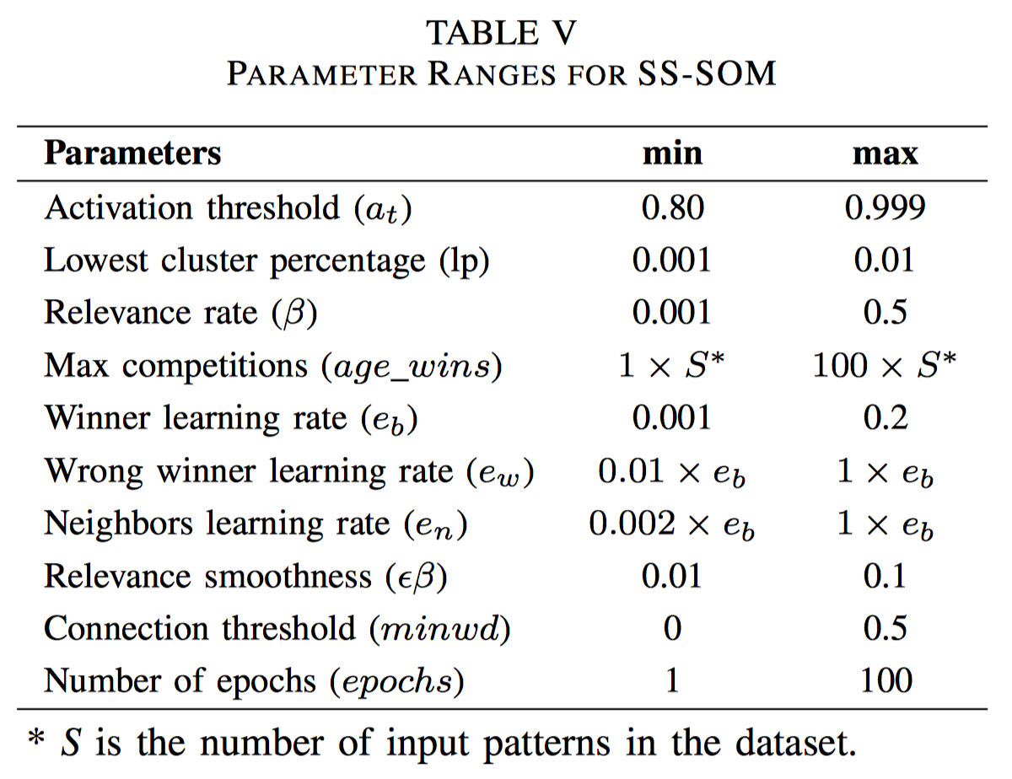
Experimental Setup

Slide 20
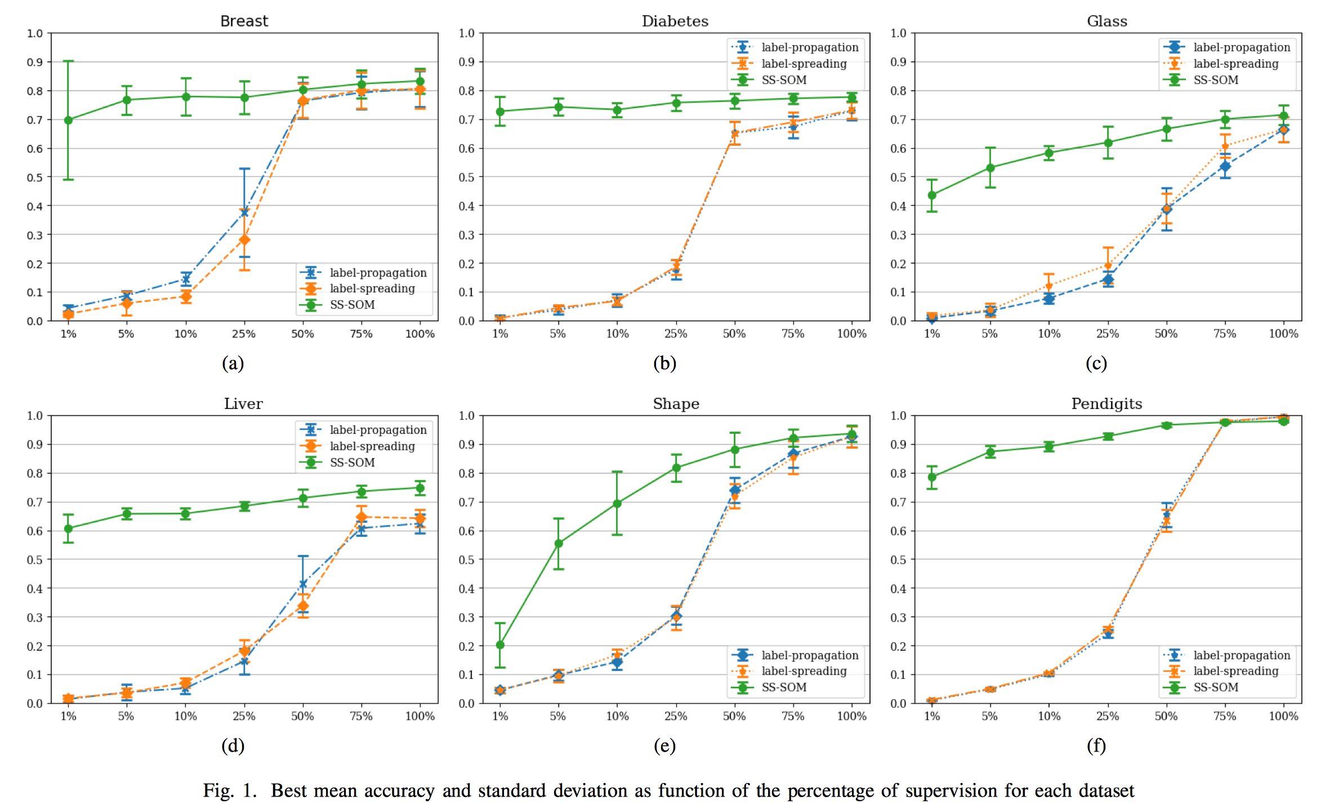
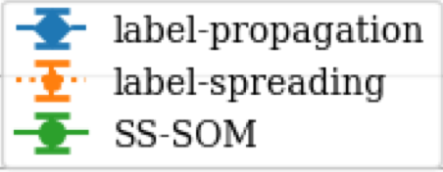
Experimental Results
Accuracy
Percentage of available labeled data

Slide 21
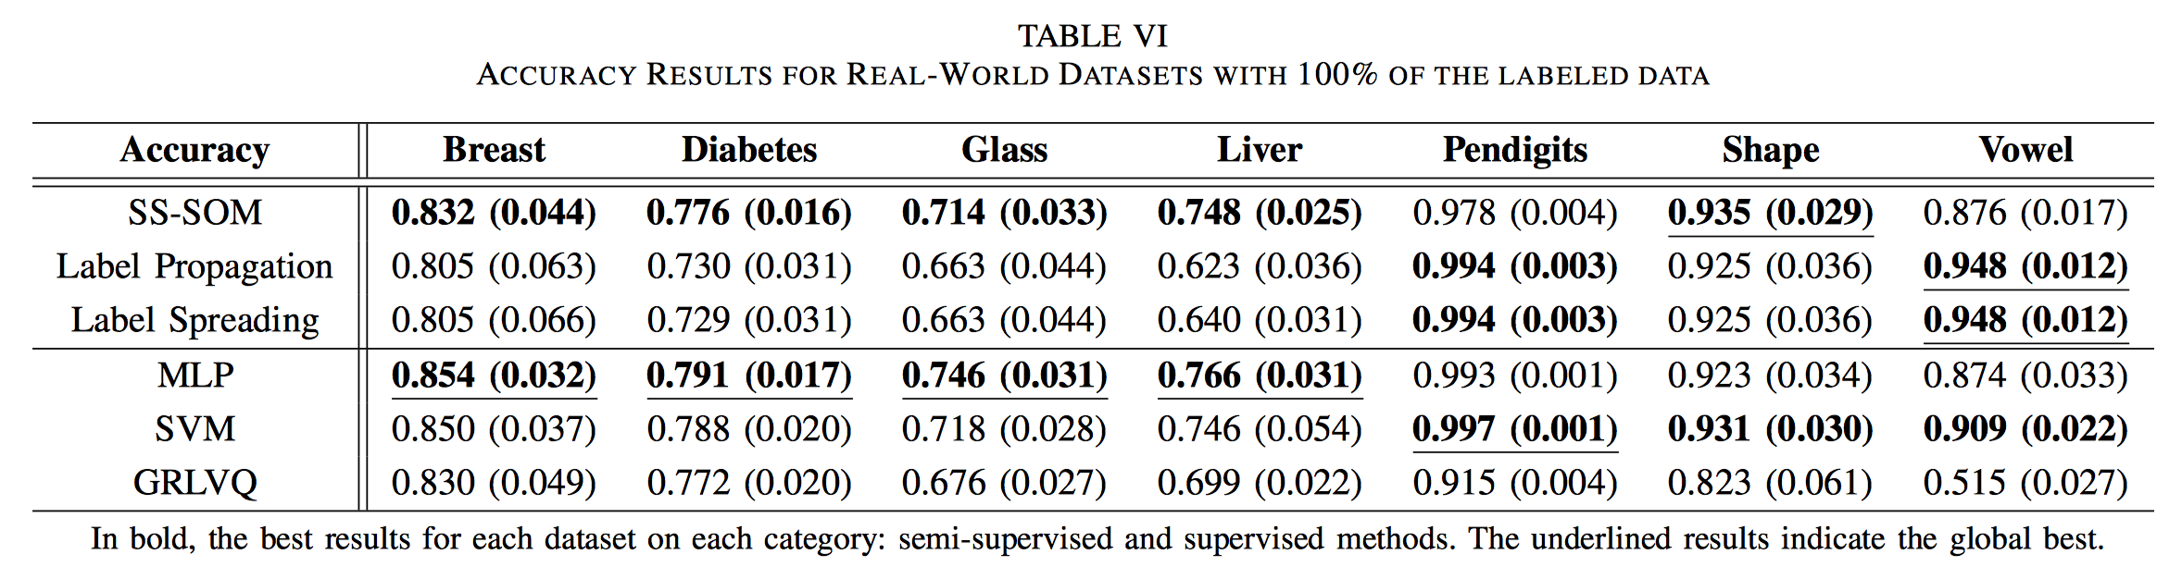
Experimental Results
≈ 2%

Slide 22
Conclusion and Future Work
This article presented an approach for classiﬁcation and clustering with semi-supervised learning
The behavior of SS-SOM was shown to have led to signiﬁcant improvements in classiﬁcation results for small amounts of labeled data
Showed its robustness under this condition, being better than other semi-supervised, achieving impressive results even with only 1% of labeled data
Using 100% of the labels, SS-SOM showed results better than or at least close to the best found in comparison with others supervised and semi-supervised methods, even with it not being the objective of this work

Slide 23
Conclusion and Future Work
When there is no labeled sample available, SS-SOM works exactly as LARFDSSOM, inheriting its characteristics and performance. However, when labeled samples are given, the results can be even better.
The self-organizing process is run for a number of epochs sampled from LHS, which is usually greater than the necessary to converge, even at the deﬁned interval. An adequate stop criterion is an object of study for future versions in order to reduce the training time.
With a small change, SS-SOM could also incorporate reinforcement learning, being, thus, capable of switching between three different learning approaches, to exploits several forms of information available.

Slide 24
Thank you all!
Pedro Braga
phmb4@cin.ufpe.br

